Slide 1
EMPOWERING
YOUR FLEXIBILITY
FME
May 2026

Slide 2
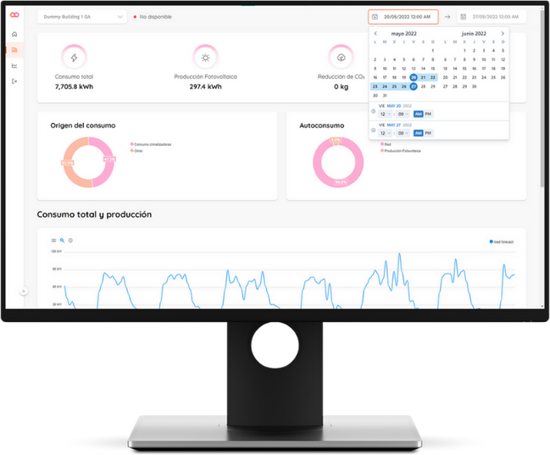
Flexibility‑as‑a‑Service:
AI‑powered software platform for energy utilities
Bamboo Energy offers the first end‑to‑end, AI‑powered energy flexibility software platform built for utilities
With one unified platform, you can
Forecast
Optimise
Manage
Monetise
Predict local renewable generation, demand and flexibility potential
Optimise energy flexibility operations and participation across all energy and reserve markets
Manage flexible assets in real time across your entire portfolio
Monetise flexibility while increasing operational efficiency

Slide 3



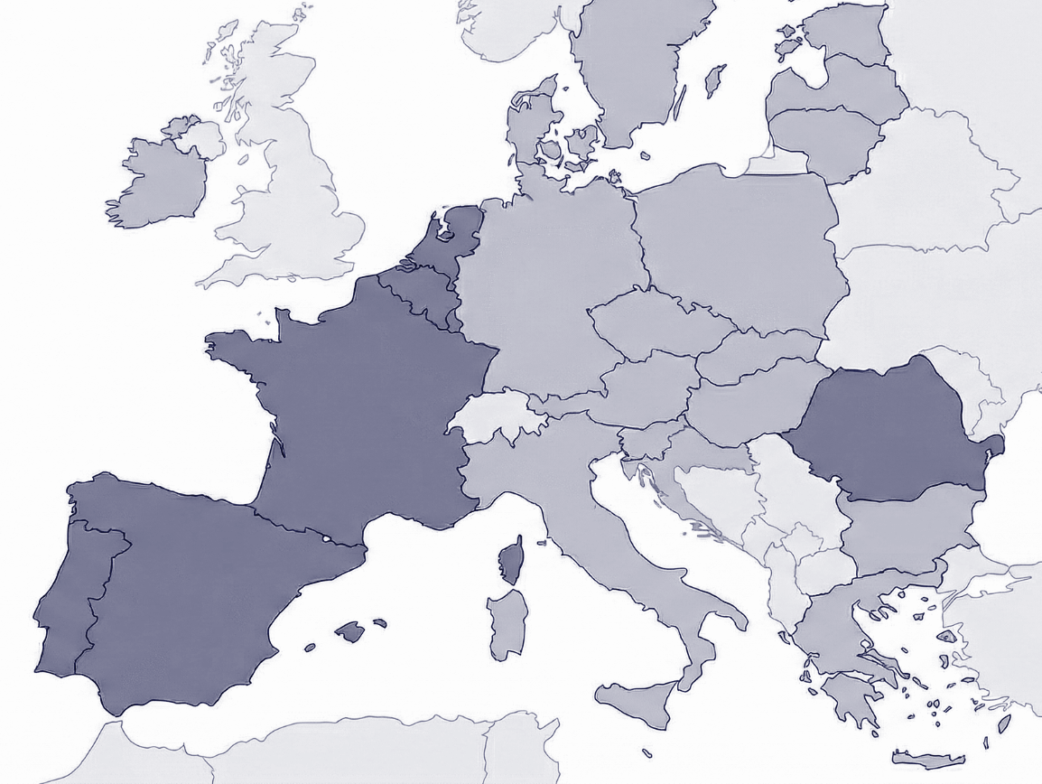








Core capabilities:
ESCOs.
C&I Implicit Flex.
BENELUX
+ 15 utilities
Key products:
Explicit Flex: aFRR, mFRR, SRAD.
Implicit Flex: Load Shifting, price arbitrage, peak shaving.
SPAIN
Strategic Partnership:
Solutions.
ROMANIA
28% costs reduction for end-user
312 k€/MW/year utility revenues
Key focus areas:
HVAC optimisation.
BESS.
Utility Retail (explicit flex via aFRR and mFRR).
3 utilities
Key products:
BESS.
C&I Implicit Flex.
FRANCE
PORTUGAL

Slide 4
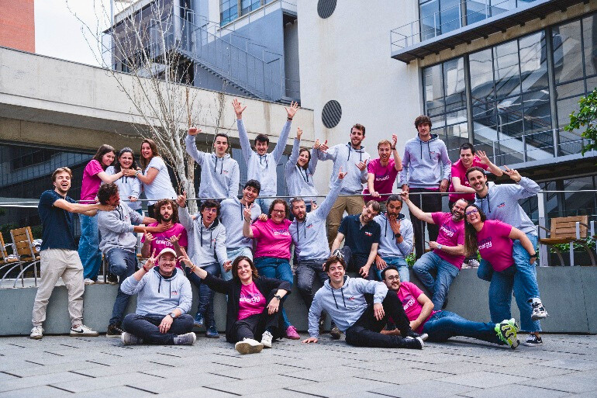









The people making it happen
35
FTE in 2025
Manel Sanmartí
CEO & Co-founder
+20 years energy industry, technology management
Cristina Corchero (PhD)
CTO & Co-founder
+15 years electricity markets, technology development
70%
MSc PhD
10%
Mattia Barbero (PhD)
Product & Co-founder
+10 years energy markets, DR/Flex
Carles Leg
Head Sales
+25 years Sales
& BDev
Chiara Carrani
Head PMO
+15 years Project Management
Antoni Company
Product Owner
+10 years energy markets
Alba Colet
Head Engineering
+15 years Software dev & coms

Slide 5

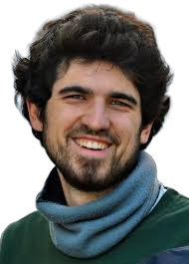


PhD & Bamboo Energy
Cristina Corchero
MSc Statistics and OR
PhD Statistics and OR
Short Term Bidding Strategies for a Generation Company in the Iberian Electricity Market
Mattia Barbero
MSc Energy Management
PhD Statistics and OR
Demand aggregator optimal strategies: from the bidding to the execution
Adrià Martin
MSc Architecture
PhD Energy & Buildings
Exploring home heating practices: A social and technical analysis of space heating with hybrid heat pumps operated by smart controls
Industrial PhD
Marcel Bernet
MSc Mathematics
PhD Astrophysics and quantum physics
Data-driven diagnosis of the Milky Way disk dynamics ﻿
Industrial PhD
Toni Company
MSc Statistics and OR
PhD Statistics and OR
Optimal integration
of Local Energy Communities

Slide 6


Why doing a PhD within a company?
Real professional experience combined with high level training.
Better employability on a non-research post-doc environment.
Network in and out the university / research environment.
Two potential paths as a post-doc: research & university or industry.
Research with direct impact

Slide 7

Why a company
would need a PhD?
Strategic decision – high level profiles with high expectations working on real problems.
Scientific excellence – beyond the state of the art.
Innovation and research in the DNA- innovation and research on the companies require people aiming to do it!
Research with direct impact

Slide 8
Gràcies!!!!
Dra. Cristina Corchero
ccorchero@bambooenergy.tech

